Slide 1

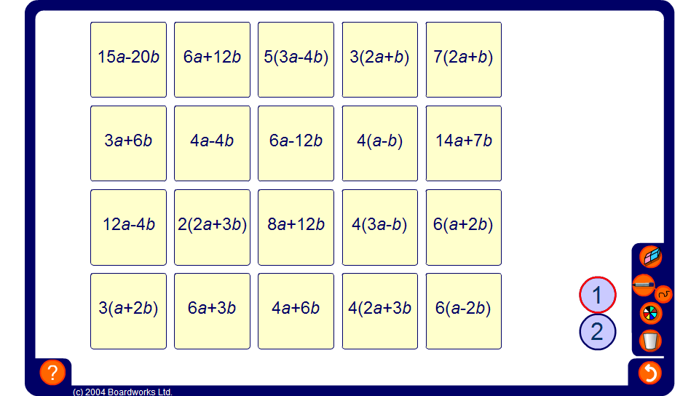


Pelmanism: Equivalent expressions
Notes:
Work together as a class to match equivalent expressions.

